Slide 1
Chapter – 8
Key Value Databases

Slide 2

Introduction
A key-value store is a simple hash table, primarily used when all access to the database is via primary key. Think of a table in a traditional RDBMS with two columns, such as ID and NAME, the ID column being the key and NAME column storing the value. In an RDBMS, the NAME column is restricted to storing data of type String.
The application can provide an ID and VALUE and persist the pair; if the ID already exists the current value is overwritten, otherwise a new entry is created.

Slide 3
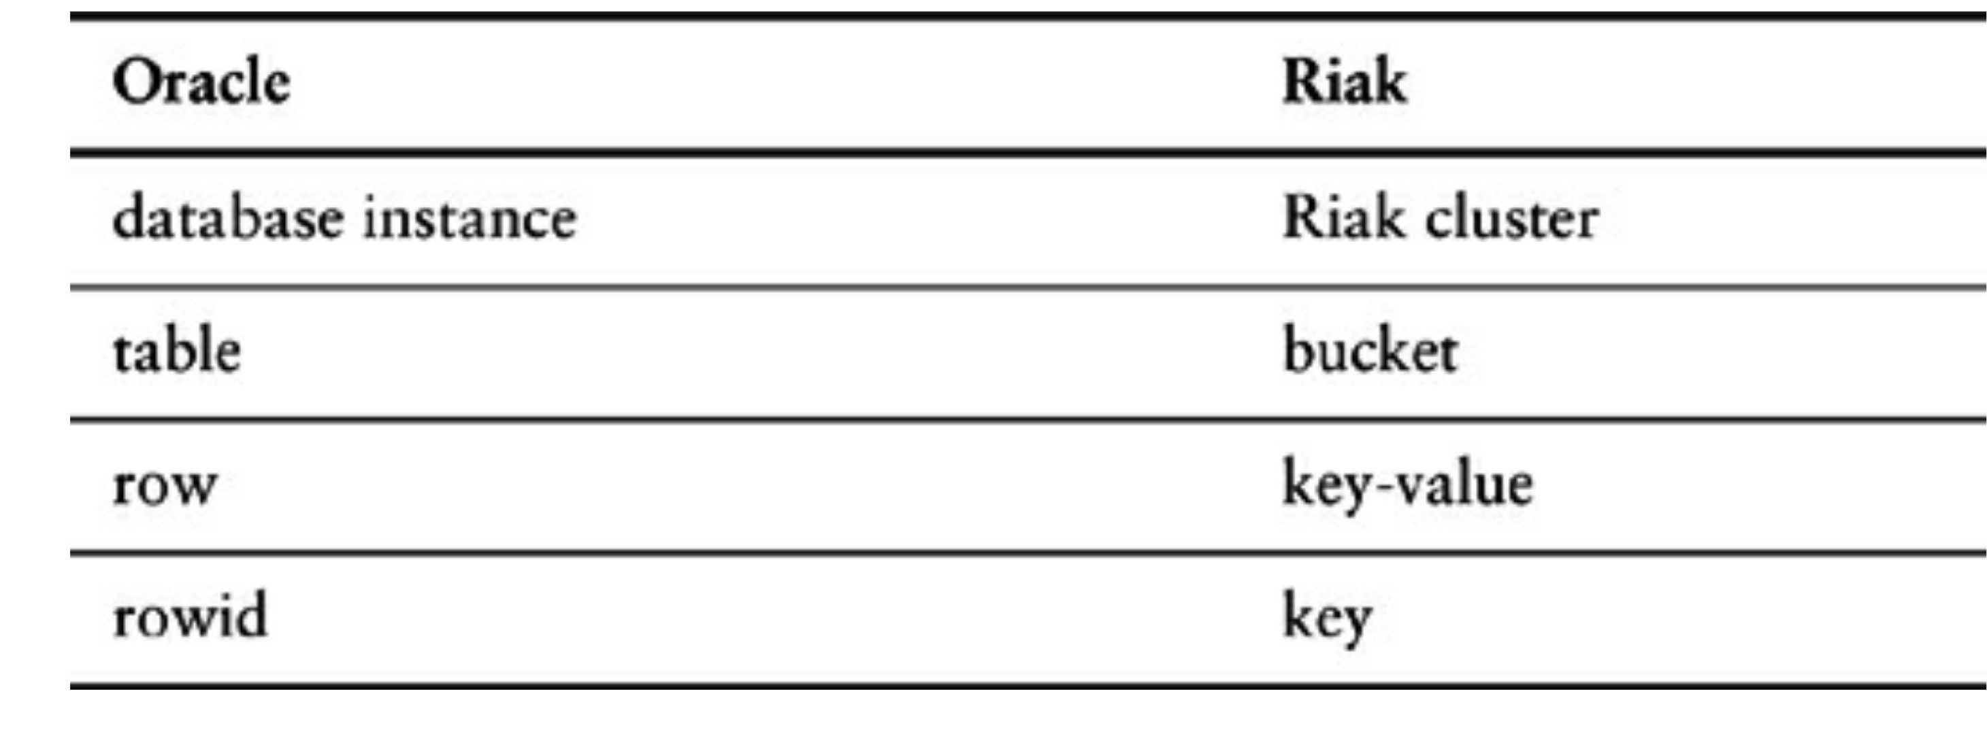
Introduction
Let’s look at how terminology compares in Oracle and Riak.

Slide 4
What Is a Key-Value Store
Key-value stores are the simplest NoSQL data stores.
The client can get the value for the key, put a value for a key, or delete a key from the data store.
The value is a blob that the data store just stores, without caring or knowing what’s inside; it’s the responsibility of the application to understand what was stored.
Key-value stores always use primary-key access to achieve great performance.
Example key-value databases: Riak, Redis, Berkeley DB, HamsterDB, Amazon DynamoDB.
BLOB stands for “Binary Large Object” and represents a database type to store binary data

Slide 5
What Is a Key-Value Store
Riak lets us store keys into buckets, which are just a way to segment the keys
If we wanted to store user session data, shopping cart information, and user preferences in Riak, we could just store all of them in the same bucket with a single key and single value for all of these objects.
In this scenario, we would have a single object that stores all the data and is put into a single bucket

Slide 6
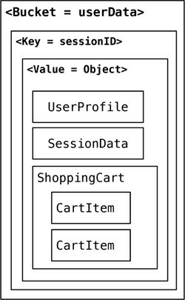
What Is a Key-Value Store
Storing all the data in a single bucket

Slide 7
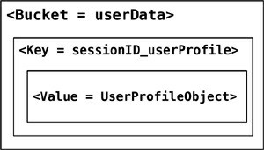
What Is a Key-Value Store
The downside of storing all the different objects (aggregates) in the single bucket would be that one bucket would store different types of aggregates, increasing the chance of key conflicts.
An alternate approach would be to append the name of the object to the key, such as 288790b8a421_userProfile, so that we can get to individual objects as they are needed
Change the key design to segment the data in a single bucket.

Slide 8
What Is a Key-Value Store
We could also create buckets which store specific data. In Riak, they are known as domain buckets.
Using domain buckets or different buckets for different objects (such as UserProfile and ShoppingCart) segments the data across different buckets allowing you to read only the object you need without having to change key design.

Slide 9
Key-Value Store Features
Consistency
Transactions
Query features
Structure of the data
Scaling

Slide 10
Consistency
In distributed key-value store implementations like Riak, the eventually consistent model of consistency is implemented. Since the value may have already been replicated to other nodes, Riak has two ways of resolving update conflicts:
Either the newest write wins and older writes loose
Both (all) values are returned allowing the client to resolve the conflict.
In Riak, these options can be set up during the bucket creation.

Slide 11
Consistency
Buckets are just a way to namespace keys so that key collisions can be reduced—for example, all customer keys may reside in the customer bucket.
When creating a bucket, default values for consistency can be provided, Ex: a write is considered good only when the data is consistent across all the nodes where the data is stored.

Slide 12
Consistency
Bucket bucket = connection
.createBucket(bucketName)
.withRetrier(attempts(3))
.allowSiblings(siblingsAllowed)
.nVal(numberOfReplicasOfTheData)
.w(numberOfNodesToRespondToWrite)
.r(numberOfNodesToRespondToRead)
.execute();
If we need data in every node to be consistent, we can increase the numberOfNodesToRespondToWrite set by w
to be the same as nVal. Of course doing that will decrease the write performance of the cluster.

Slide 13
Bucket Creation: It is creating a new bucket with a specified name (bucketName) in a data storage system. A bucket is a logical container for storing data.
Retrier Configuration: It configures a retrier for handling retries in case of failures. The withRetrier(attempts(3)) part suggests that it will attempt the operation up to three times in case of failure. Retries are often used to improve the reliability of operations in distributed systems.
Siblings Configuration: It specifies whether siblings (potentially conflicting versions of data) are allowed in this bucket. The variable siblingsAllowed likely determines whether or not conflicting versions of data can coexist in the same bucket.
Replication Configuration: It sets the number of replicas for the data stored in this bucket. The numberOfReplicasOfTheData variable likely determines how many copies of each piece of data will be maintained for fault tolerance and data durability.
Write and Read Configuration: It sets the w (number of nodes to respond to write) and r (number of nodes to respond to read) values. These values can control the consistency and availability of data operations. For example, you might require a certain number of nodes to respond before considering a write or read operation successful.
Execution: Finally, the execute() method is called to actually create the bucket with the specified configurations.

Slide 14
Consistency
To improve on write or read conflicts, we can change the allowSiblings flag during bucket creation: If it is set to false, we let the last write to win and not create siblings.

Slide 15
Transactions
Many data stores do implement transactions in different ways. Riak uses the concept of Quorum implemented by using the W value —replication factor—during the write API call.

Slide 16
Query Features
All key-value stores can query by the key—and that’s about it.
If you have requirements to query by using some attribute of the value column, it’s not possible to use the database.
Query by key also has an interesting side effect. What if we don’t know the key? Most of the data stores will not give you a list of all the primary keys; even if they did, retrieving lists of keys and then querying for the value would be very cumbersome(heavy and difficult to carry). Some key-value databases get around this by providing the ability to search inside the value, such as Riak Search.

Slide 17
Query Features
While using key-value stores, lots of thought has to be given to the design of the key. Can the key be generated using some algorithm? Can the key be provided by the user (user ID, email, etc.)? Or derived from timestamps or other data that can be derived outside of the database?

Slide 18
Structure of Data
Key-value databases don’t care what is stored in the value part of the key-value pair.
The value can be a blob, text, JSON, XML, and so on.

Slide 19
Scaling
Many key-value stores scale by using sharding. With sharding, the value of the key determines on which node the key is stored.
Let’s assume we are sharding by the first character of the key; if the key is f4b19d79587d, which starts with an f, it will be sent to different node than the key ad9c7a396542. This kind of sharding setup can increase performance as more nodes are added to the cluster.
Sharding also introduces some problems. If the node used to store f goes down, the data stored on that node becomes unavailable, nor can new data be written with keys that start with f.

Slide 20
Suitable Use Cases
Let’s discuss some of the problems where key-value stores are a good fit:
Storing Session Information: Since everything about the session can be stored by a single PUT request or retrieved using GET. This single-request operation makes it very fast, as everything about the session is stored in a single object.
User Profiles, Preferences: Almost every user has a unique userId, username, or some other attribute, as well as preferences such as language, color, timezone, which products the user has access to, and so on. This can all be put into an object, so getting preferences of a user takes a single GET operation.
Shopping Cart Data

Slide 21
Suitable Use Cases
Let’s discuss some of the problems where key-value stores are a good fit:
Shopping Cart Data: E-commerce websites have shopping carts tied to the user. As we want the shopping carts to be available all the time, across browsers, machines, and sessions, all the shopping information can be put into the value where the key is the userid.

Slide 22
When Not to Use
There are problem spaces where key-value stores are not the best solution:
Relationships among Data: If you need to have relationships between different sets of data, or correlate the data between different sets of keys, key-value stores are not the best solution to use.
Multioperation Transactions: If you’re saving multiple keys and there is a failure to save any one of them, and you want to revert or roll back the rest of the operations, key-value stores are not the best solution to be used.

Slide 23
When Not to Use
There are problem spaces where key-value stores are not the best solution:
Query by Data: If you need to search the keys based on something found in the value part of the key-value pairs, then key-value stores are not going to perform well for you. There is no way to inspect the value on the database side, with the exception of some products like Riak Search
Operations by Sets: Since operations are limited to one key at a time, there is no way to operate upon multiple keys at the same time. If you need to operate upon multiple keys, you have to handle this from the client side.

Slide 24
THANK YOU

